Slide 1

Railway Ticket Reservation and Passenger Management System with Seat Allocation and Cancellation Using Structures and File Processing
Guided by
Dr.S.K.Saravanan
Presented by:
S.S.Sai Chandan(192312190)
M.Charan Teja Reddy(192312232)
Obulesh(192312243)

Slide 2


INTRODUCTION
Railways are one of the most widely used modes of transportation, making an efficient ticket reservation and passenger management system essential.
Traditional reservation methods involve manual work and may lead to booking errors, seat allocation issues, and delays in ticket cancellation.
The system uses C programming, structures to store passenger details, and file processing to save and retrieve reservation records efficiently.
It provides fast ticket booking, automatic seat allocation, easy ticket cancellation, and accurate passenger record management, improving the overall efficiency of railway reservation services.

Slide 3
PROBLEM STATEMENT
Manual ticket booking is slow and error-prone.
Seat allocation may become inaccurate or duplicated.
Managing passenger records manually is difficult.
Ticket cancellation and record updates take time.
Data may be lost without proper file storage.
An automated system is needed for efficient reservation and passenger management.

Slide 4
EXISTING SYSTEM
Existing railway reservation systems rely on manual procedures or basic computerized applications.
Seat allocation is not fully optimized, which may lead to booking conflicts and inefficient utilization of available seats.
Ticket cancellation and record modification require additional processing time.
Reservation data management and retrieval are less efficient due to limited file handling capabilities.
The existing system lacks an integrated approach for efficient passenger management, seat allocation, and secure record maintenance.

Slide 5
PROPOSED SYSTEM
The proposed system automates railway ticket reservation and passenger management using C programming.
It uses structures to efficiently store and manage passenger and reservation details.
File processing ensures secure storage and easy retrieval of reservation records.
The system provides automatic seat allocation based on seat availability.
It supports quick ticket cancellation and updates seat availability instantly.
The proposed system improves accuracy, reduces manual effort, and enhances the overall efficiency of railway reservation operations.

Slide 6
Module 1:Train & Seat Availability Management
Train Registration : Add new trains with unique train numbers.
Train Modification : Update train name, route, or seat capacity.
Train Deletion : Remove a train from the system when required.
Train Search :Search trains using train number, source, or destination.
Route Management : Maintain source and destination details for each train.

Slide 7
Module 2 : Passenger Registration & Ticket Booking
Passenger Registration : Register passengers by collecting their personal details.
Passenger ID Generation : Assign a unique ID to each passenger.
Passenger Name :Store the passenger's full name.
Age and Gender : Record age and gender for each passenger.
Contact Details :Store the passenger's phone number or contact information.

Slide 8
Module 3:Ticket Cancellation & Reservation Record Management
Ticket Search : Find a reservation using ticket number or passenger ID.
Cancellation Request :Allow passengers to request cancellation of a booked ticket.
Ticket Verification :Verify the ticket details before processing cancellation.
Passenger Verification :Confirm that the passenger information matches the reservation.
Cancellation Confirmation :Confirm the cancellation after successful processing.
Seat Release : Make the cancelled seat available for another passenger.

Slide 9
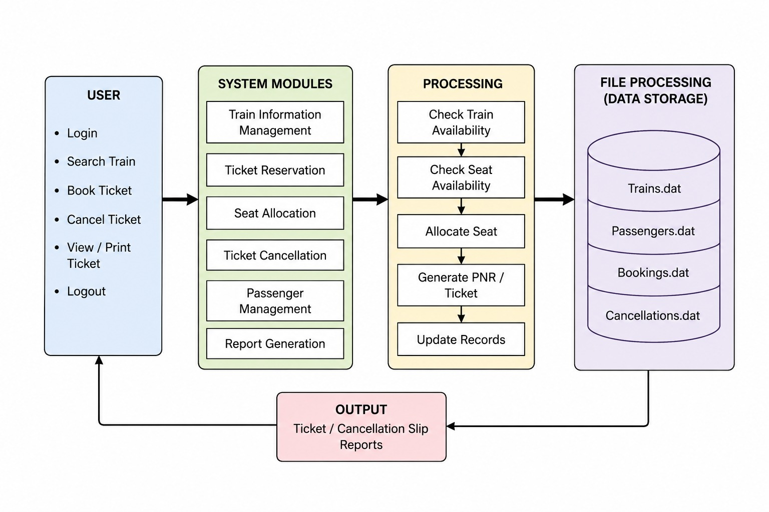
BLOCK DIAGRAM

Slide 10
CONCLUSION
It automates ticket booking, passenger record management, seat allocation, and ticket cancellation using C programming.
The system reduces manual effort, minimizes booking errors, and improves the overall efficiency of railway reservation operations.
Overall, the proposed system offers a simple, accurate, and user-friendly solution for effective passenger and ticket management.

Slide 11
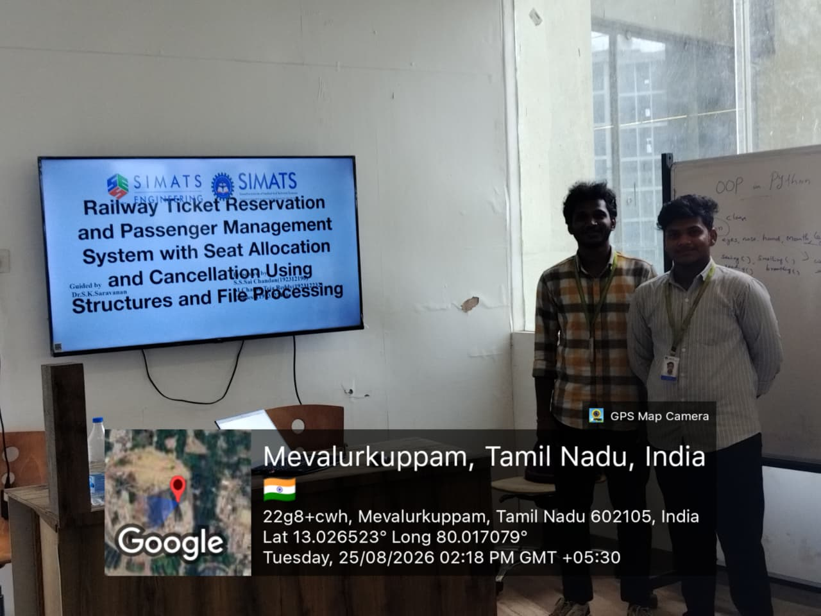
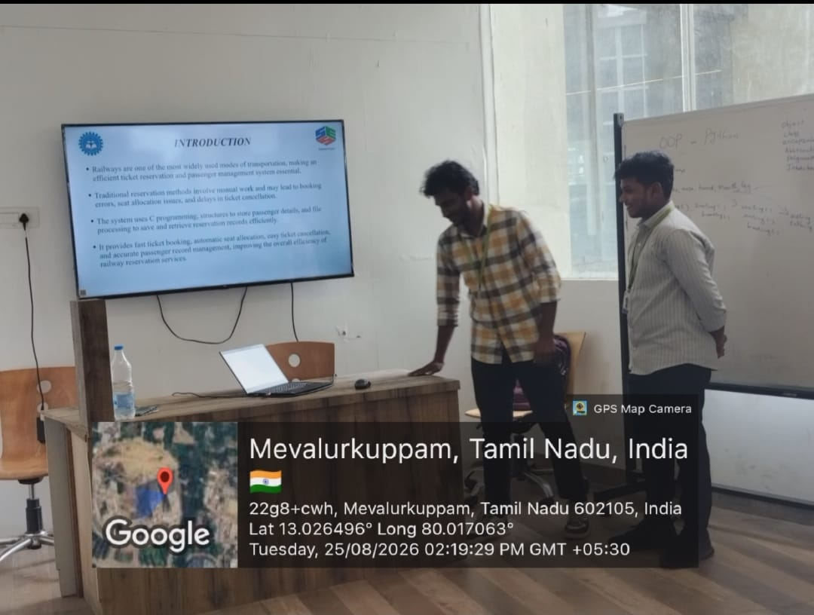
GEOTAG PHOTOS:

Slide 12
THANK YOU

